Slide 1
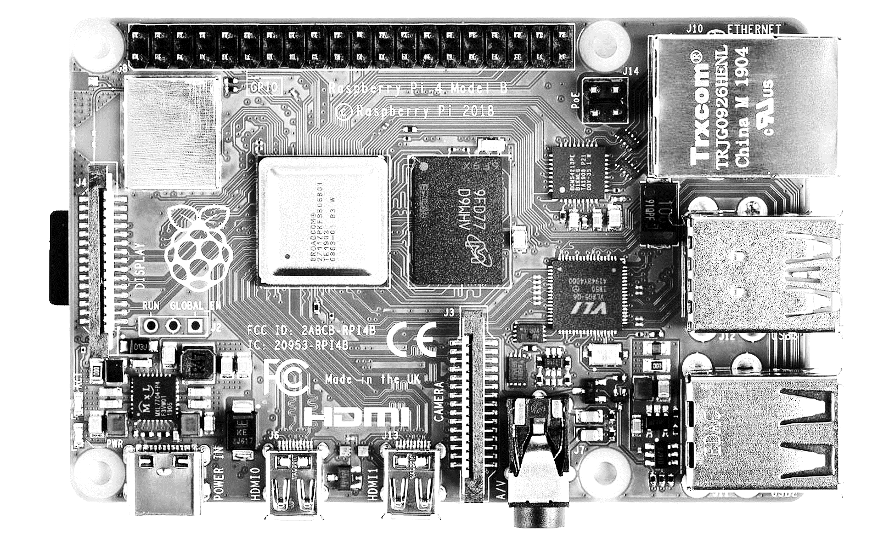
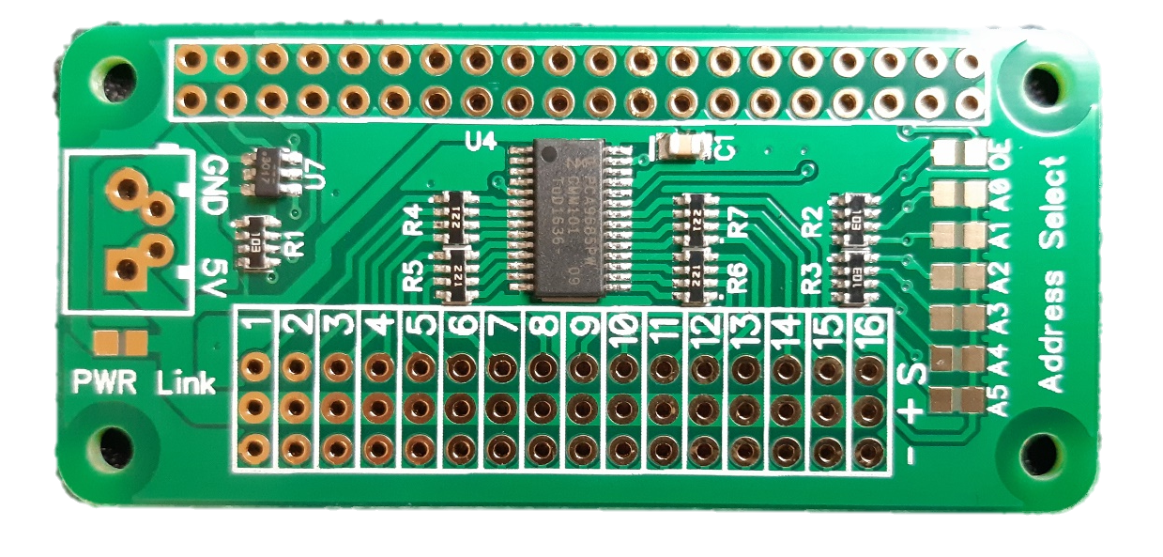
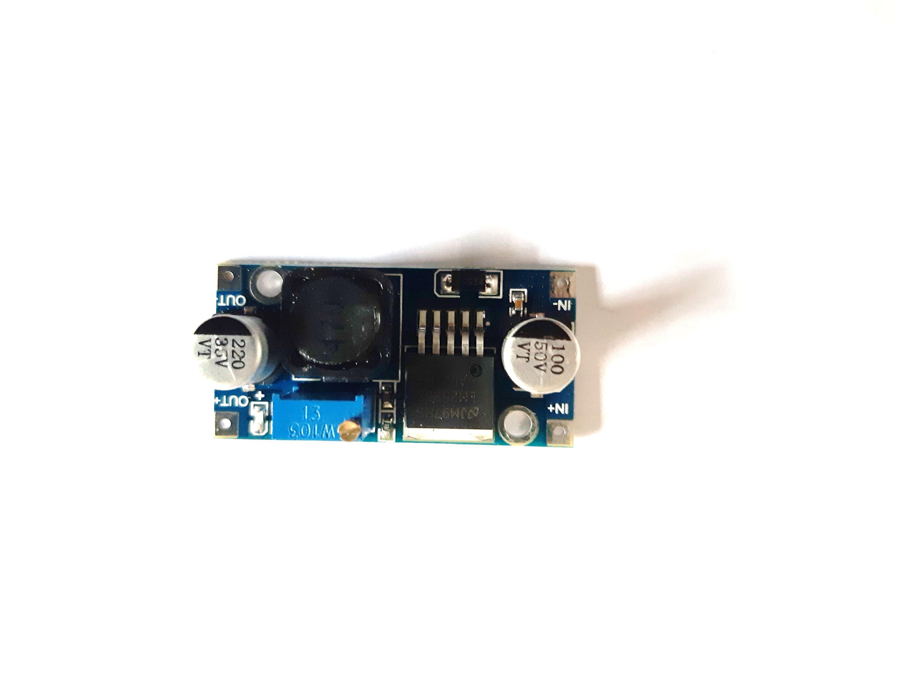
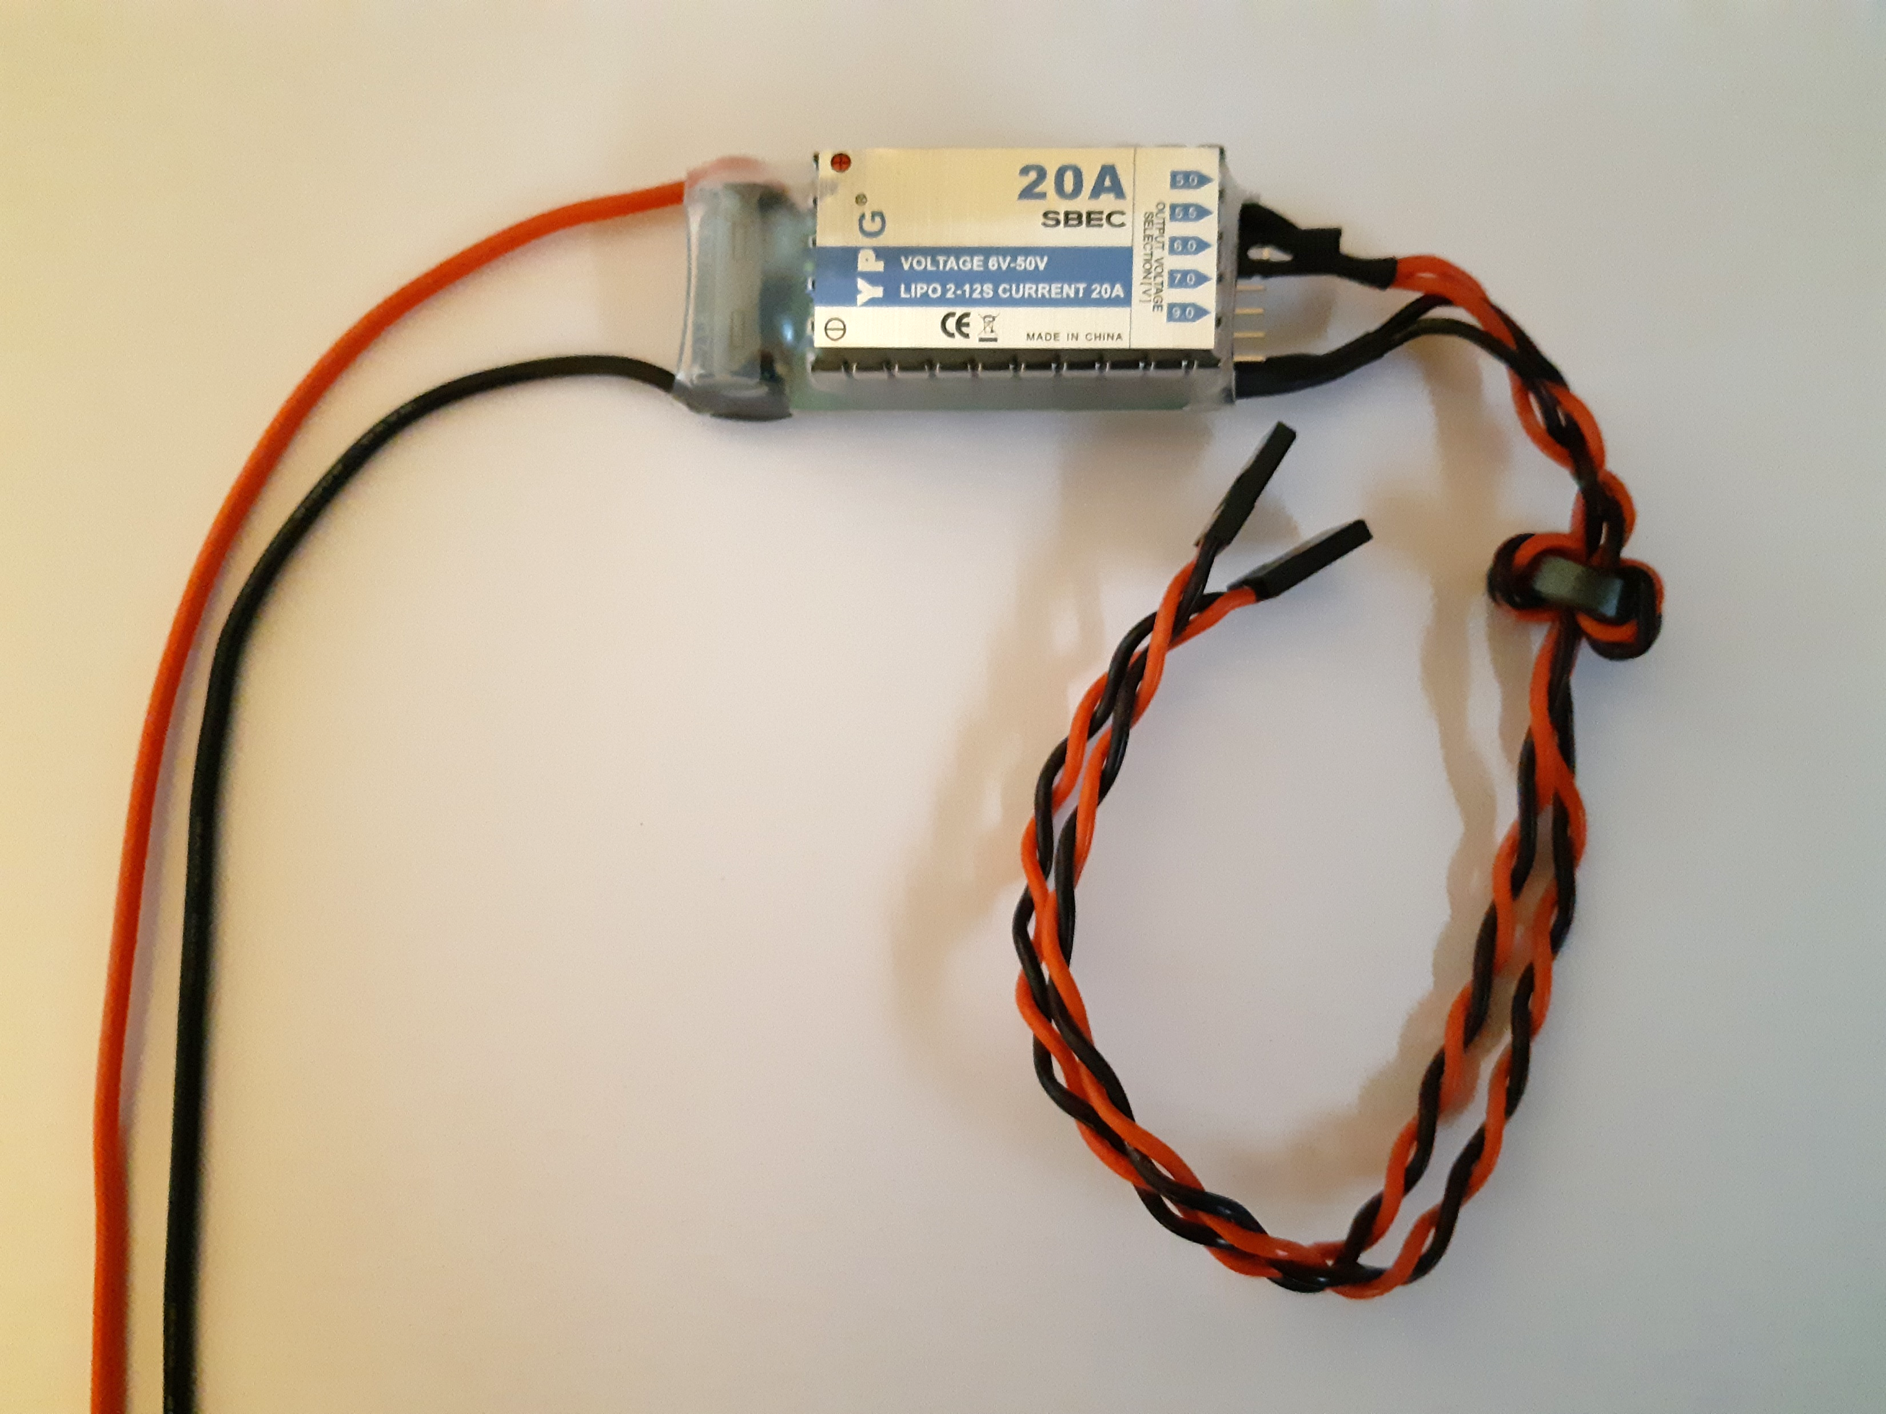
PCA9685 PI ZERO Shield
3A SBEC/DCDC
GND
+5V
Bridge PWR with solder in order to supply powe to both PWM shield and RPI4
Cut these tracks (+) here
+6V to +8.4V depending on servo max voltage
Strap (optional) if change of I2c address select is necessary
GND
+
20A SBEC
This model has 2 outputs with servo connectors, so I used them both
2S 4000 mAh Lipo Battery
-

